Slide 1

School Index (2nd Iteration) Recap
TAG Team
2024 Spring
Data Science
Senior Capstone Project
Client: StudyPool

Slide 2

Project Introduction
& Objective
Develop a comprehensive database of colleges, universities, and online schools in the United States tailored for student research needs.
Present data through a StudyPool website, offering centralized access to key information such as school location, website, logo, and picture, facilitating informed academic decisions.

Slide 3

Team Members/Roles
Niecia Say - Data Modeler & Team Manager
Cobi Miller - Data Analyzer & Client Liaison
Nathaniel Hemans - Visualizer & Project Documentation
Benardo Avancena - Client
Helen Merhout - Client

Slide 4

Team Plan
The plan for this iteration is as follows:
Creating a process to automate the Extraction process of ETL
Should be able to gather data from listed school websites being the school’s logo and mission statement
Gathered data should be saved as a csv to be inputted within the database
A database should be setup and allow for multiple users to connect, access, and edit the database
Should follow a set structure that current and future data will abide by
Where school logos and mission statements will be housed moving forward
A functionable website should be created following the functional requirements of the client and a simple U.I.
Will be done in HTML and CSS code for development and design

Slide 5

Status Update

Slide 6

Achievements
Perform web scraping to collect logos of schools and save them into a CSV file.
Create the foundations for the SQL database.
Identify target columns for statistics.
Begin statistical modeling.
Begin work on machine learning road map.
Found a fitting website template with accessible HTML and CSS code files
Began editing the website to suite the functional purposes of what it should achieve based on the previously created mock website.

Slide 7
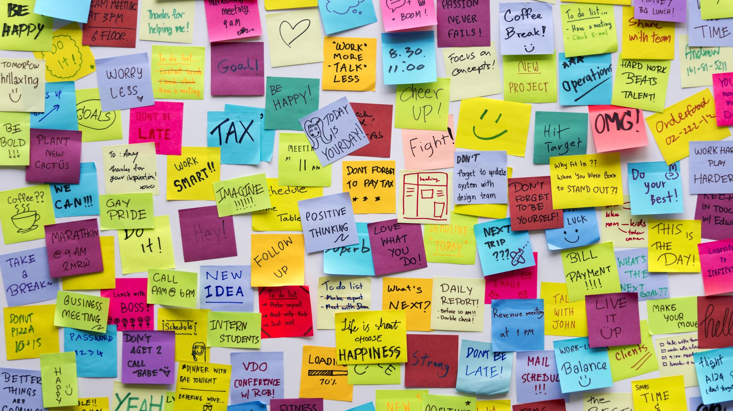
Remaining Tasks
Mission statements for schools have not been collected.
Data file for logos needs to be cleaned.
SQL database needs to be finished and published.
More development into statistics and machine learning needed.

Slide 8

Next Actions
Perform web crawling to extract mission statements from schools' websites and save the data into a CSV file.
Finish the structure of the MySQL database and link it with Studypool's APIs.
Explore possible statistical analysis opportunities within the dataset.
Find an appropriate use of an AI algorithm.
Beginning the process of connecting the website with the database based on the clients' API
Restyling the website to suite the needs of the clients' branding and color palette
Adding additional pages to when the user clicks to the home page

Slide 9
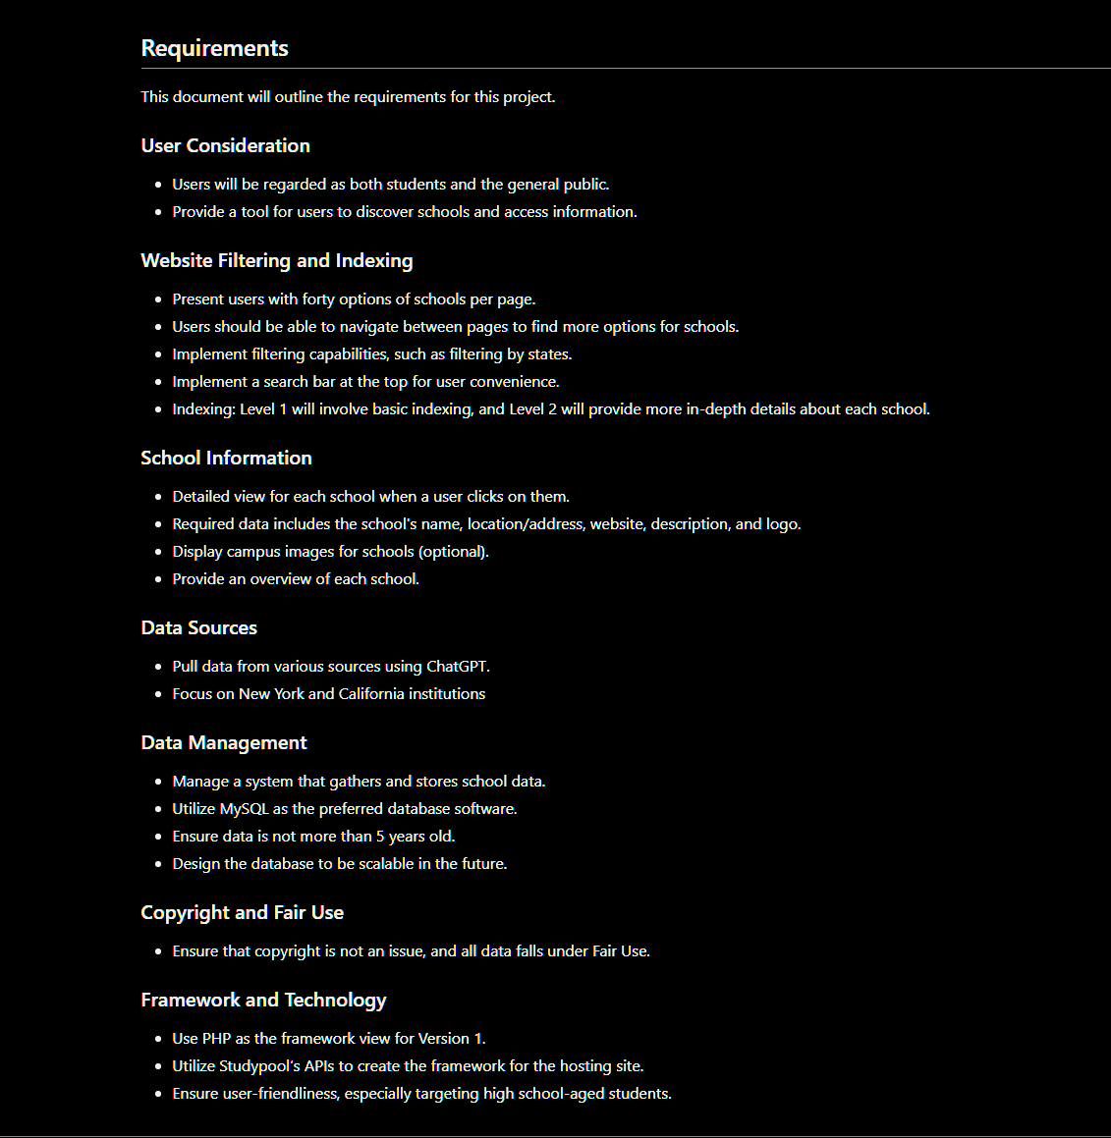
GitHub Repository

Slide 10

Dataset
Title: Comprehensive Dataset of U.S. Colleges and Universities
Source: https://www.kaggle.com/datasets/joebeachcapital/us-colleges-and-universities
Description: Provides extensive information on post-secondary educational institutions across all 50 states and U.S. territories. It includes details such as location, identifiers, contact information, population, industry codes, source references, website URLs, educational programs, enrollment statistics, housing facilities, employment data, and shelter identification.
Progress:
Cleaned dataset
Removed unnecessary columns
Filtered dataset to include 100 colleges from Georgia
Challenges Faced: Difficulty finding logos and mission statements for schools
Resolution: Implementing web scraping to gather school logos
Technologies Used: Google Colab, Serpapi, Python, Excel

Slide 11
Statistical Plans (Recap)
Longitude and Latitude
Geo Map
Location Statistics
Bar and Pie Charts
Enrollment Data
Data Analysis Technologies
R Studio, Python Notebook, Spark, Tableau
Numerical Statistics

Slide 12
Statistical Developments
Demonstrated in Colab
Decisions on columns
Simple statistics
Elementary visualizations

Slide 13
Database Setup
Beginnings of MySQL database
Choice of AlterVista or MySQL Workbench
Begin utilizing Studypool's APIs

Slide 14
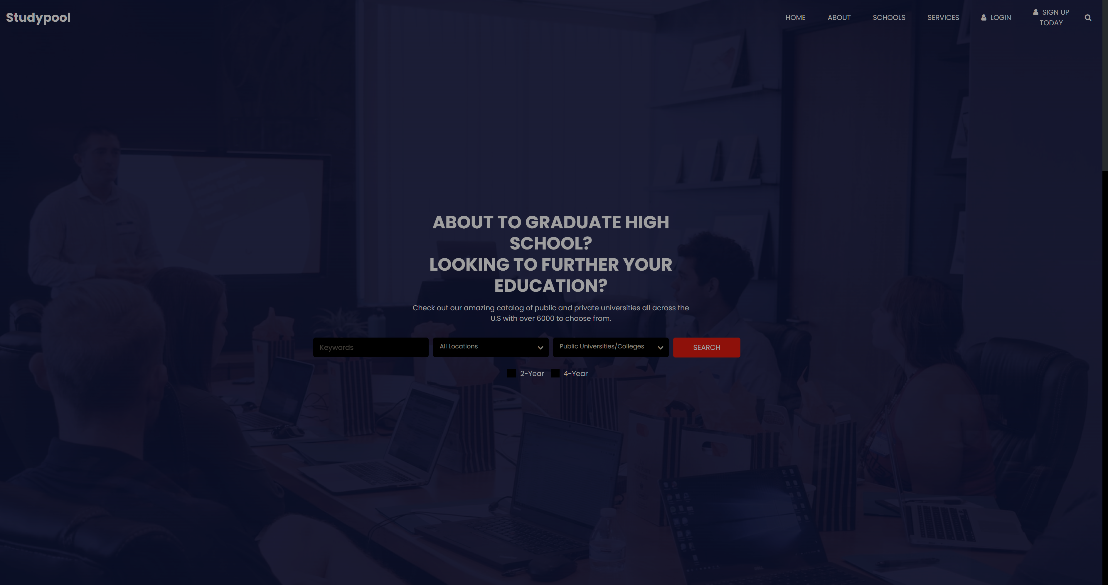
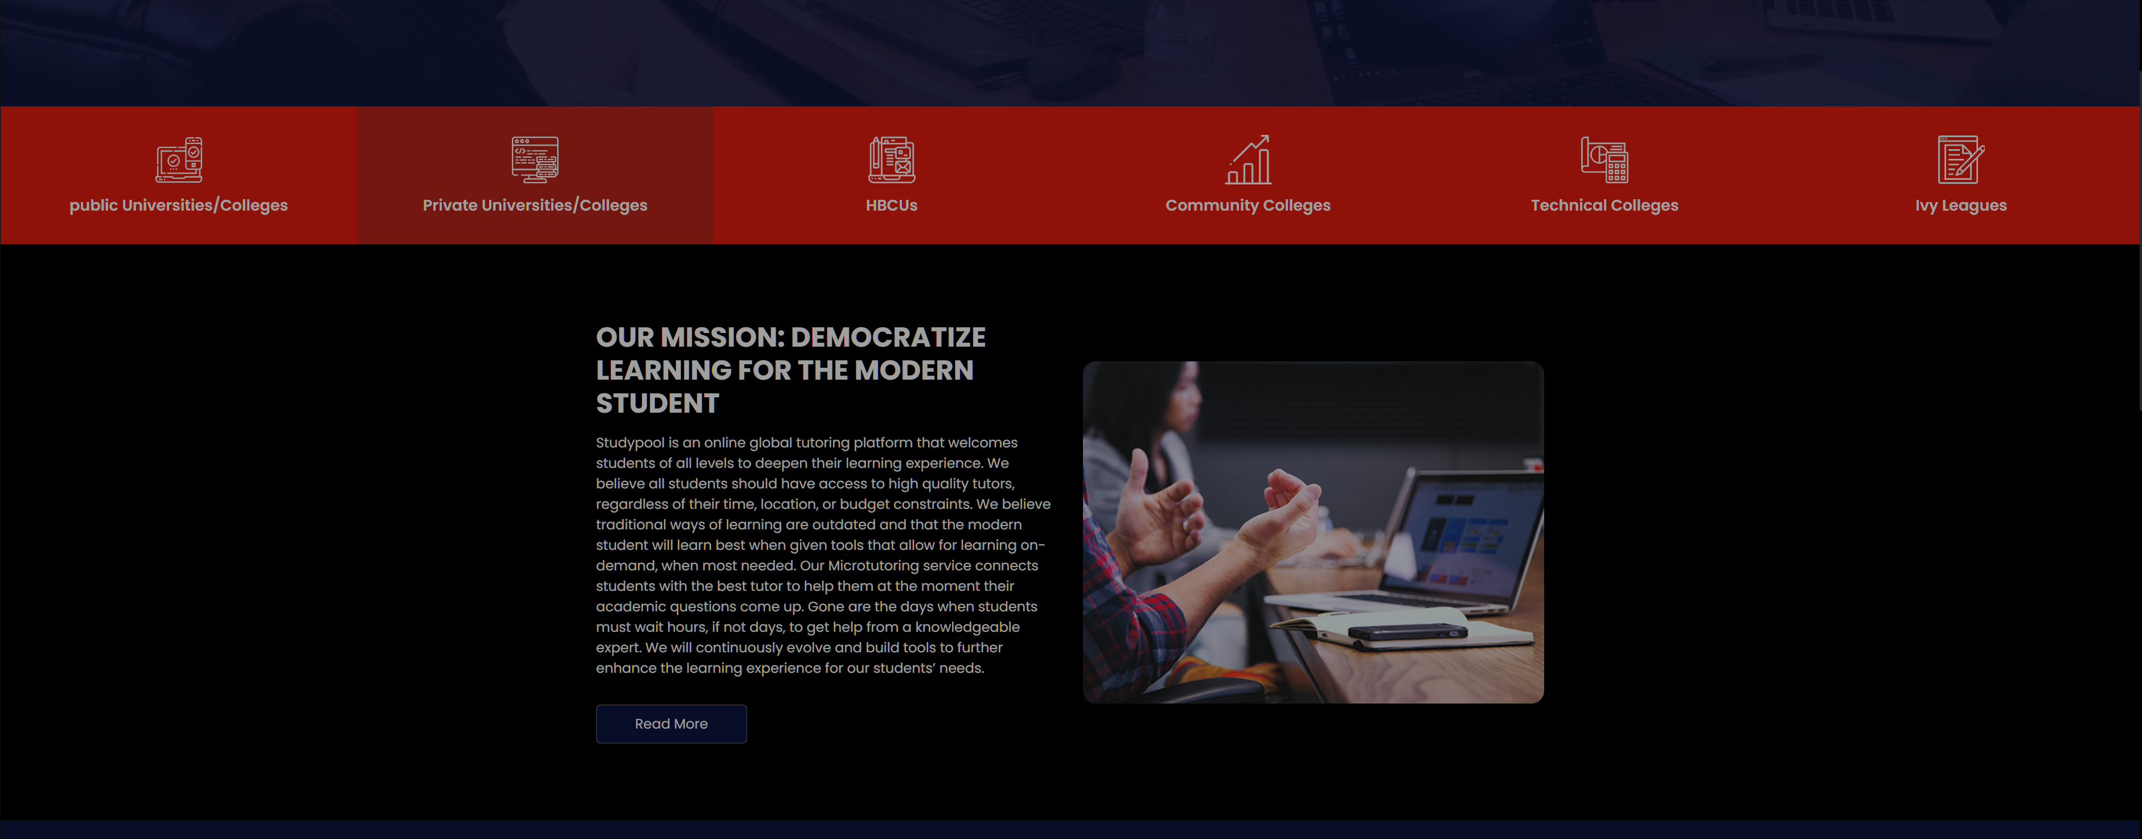
Website Prototype
Website Template Link :
Website Template Site
Website was based on a template that provides the respective HTML & CSS files for editing the site.
Goal for this iteration was to have a website that was functional in theory with proper HTML code unlike the first mock website.
Elements of the website was edited to be more in line to the functional requirements listed by the clients

Slide 15
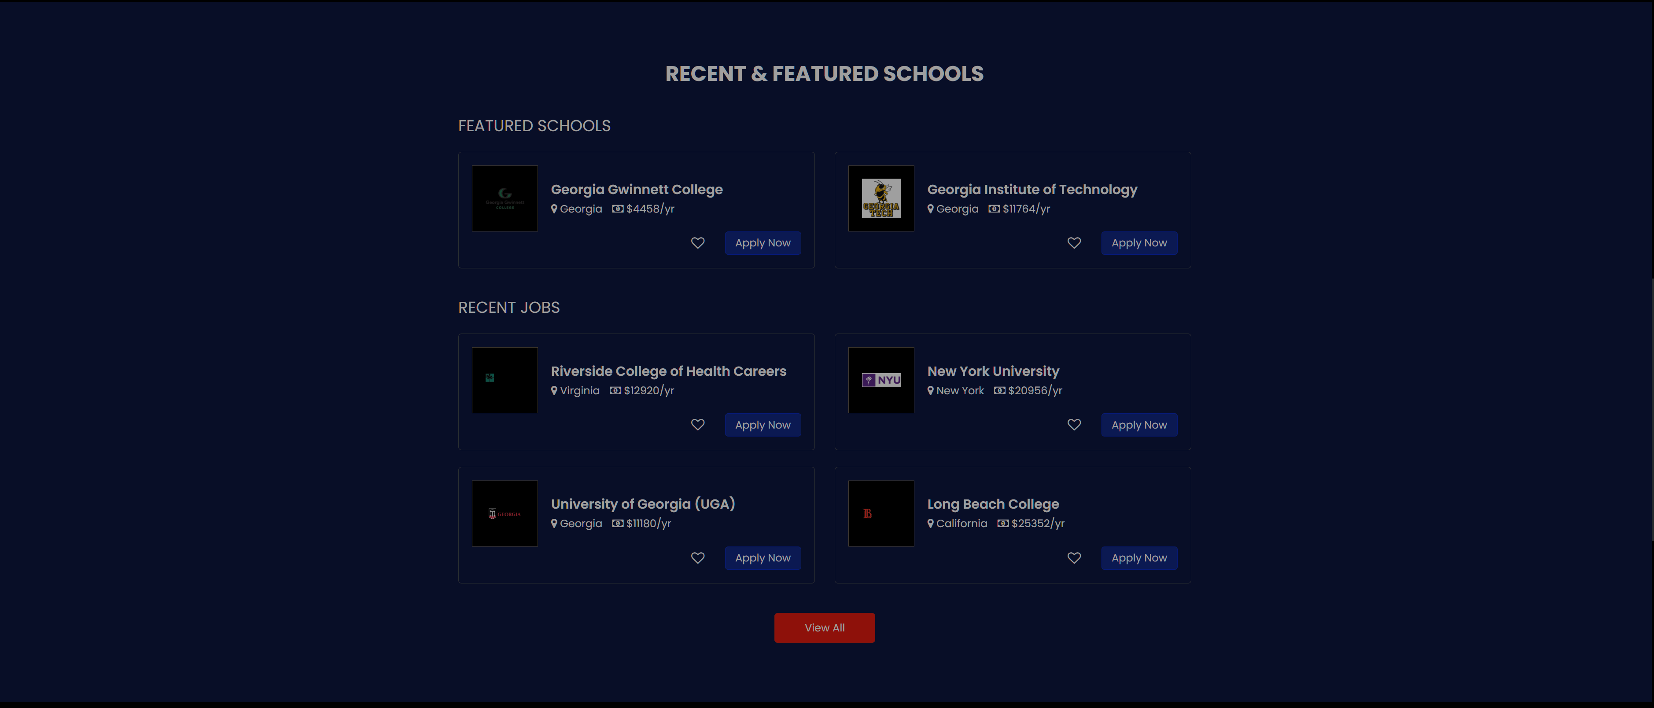

Website is majority of the way done, there are some elements that I haven't decided whether or not it would be kept in or completely removed for the time being.
I plan on (if there is time available) redesigning the website to fit the the color palette of the clients' brand
Once the database becomes fully functional, plans will be made to then connect the website to the database via the client's API

Slide 16

Client Communication
Client meeting held February 16th
Discussed how we were originally going to manually extract data for 100 schools and their thoughts on the idea.
Gathered feedback on the mock website design.
Suggested that the Extraction process be automated for added scalability.
Went over their API and how it would connect the search function of the website to the database.
Discussed if the clients wanted any statistical summary or none.
Third client meeting currently being scheduled.

Slide 17
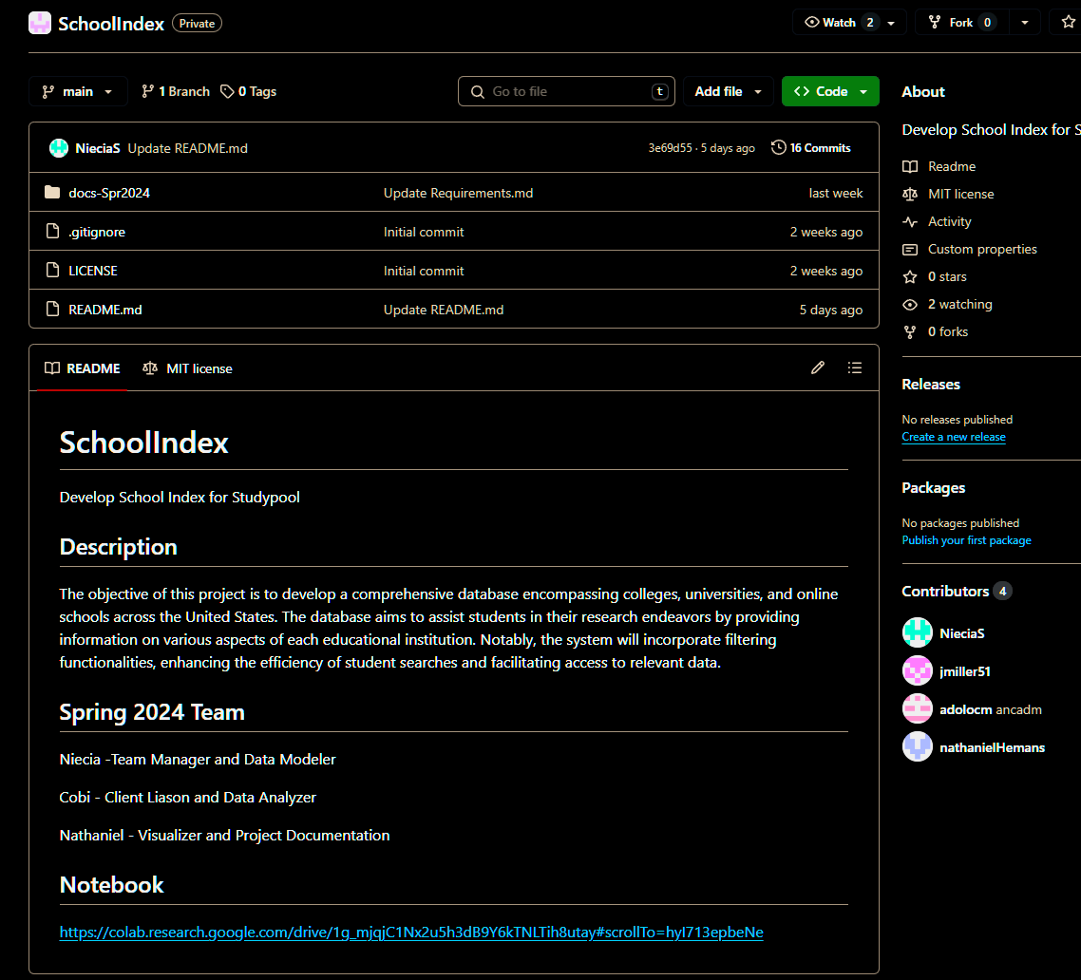
GitHub Repository

Slide 18

Links
Charter: https://onedrive.live.com/edit?id=393F7CBC5BA73909!34010&resid=393F7CBC5BA73909!34010&ithint=file%2cxlsx&authkey=!An1xB-LPWvGrOc0&wdo=2&cid=393f7cbc5ba73909
GitHub: https://github.com/GGC-DSA/SchoolIndex/tree/main
Jira: https://jira.ggc.edu/secure/RapidBoard.jspa?rapidView=203&projectKey=SCHOOL&view=planning.nodetail&issueLimit=100
Notebook: https://colab.research.google.com/drive/1g_mjqjC1Nx2u5h3dB9Y6kTNLTih8utay#scrollTo=_uC26nMALoea

Slide 19

Questions

